Slide 1


Slide 2
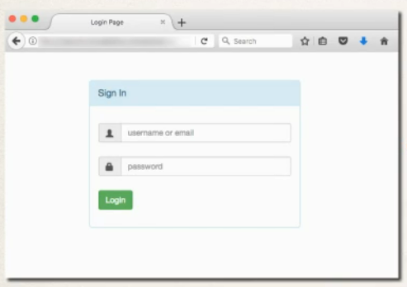
Spring Security Demo

Slide 3

HELLO!
I am Vishal Thakur
I am here because I love to give presentations.
You can find me at https://javawithvishal.com

Slide 4
THANKS!
Any questions?
You can find me at
@98269-52872 & vishalthakur107@gmail.com

